Slide 1
Drought
Plant community
Microbial community genetic composition (CAZyme domain abundance)
Microbial community function (Enzyme Vmax)

Slide 2


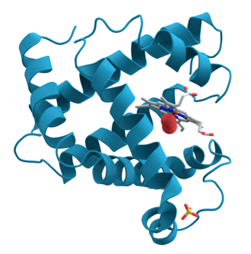

Climate
Drought
Microbial community
Functional potential
Functioning
Litter chemistry
Physiology

